Slide 1
Computer Architecture
Lab 3

Slide 2
Topics to be covered:
❑ Register Transfer Language (RTL).
❑ Common Data Bus.
❑ Types of ALU Micro-operations.

Slide 3
Part 1: Register Transfer Language (RTL)

Slide 4
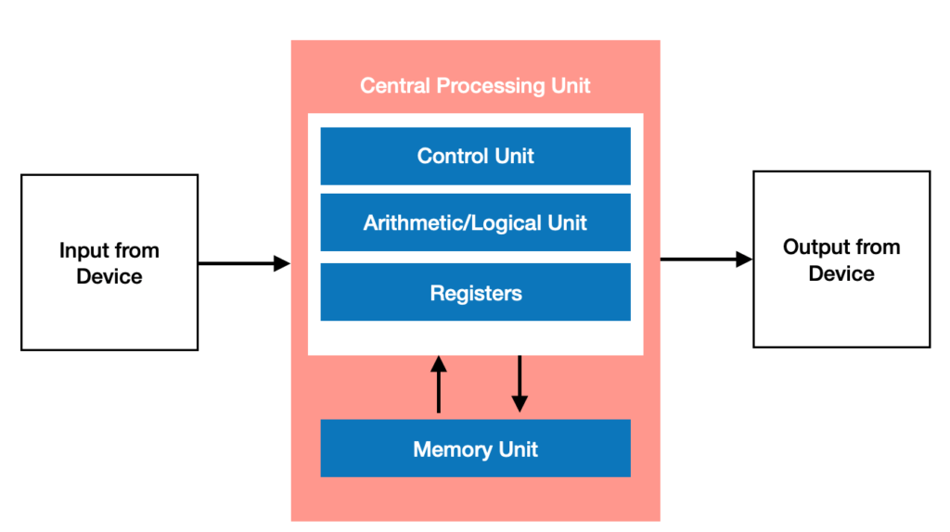
Von Neumann Architecture
Points to remember:
Control Lines
Control Signals

Slide 5
Register Transfer language (RTL)
It is the language used to describe data flow at the register-transfer level of an architecture.
For Example:
If Control line P = 1 then a transfer from R1 to R2 will be done
This is written in RTL as:
P: R2 ← R1
If Control line Q = 1 then a transfer from R1 to R2 and from R1 to R3 will be done
This is written in RTL as:
Q: R2 ← R1, R3 ← R1

Slide 6
Register Transfer language (RTL)
For Example:
If both Control lines P and Q must be equal to 1 then a transfer from R3 to R4 will be done
This is written in RTL as:
PQ: R4 ← R3
If any of the Control lines X or Y should be equal to 1 then an addition between R1 and R2 should be done and the result is stored in R3.
This is written in RTL as:
X+Y: R3 ← R1+R2
If Control line S should be equal to 0 then R1 will be transferred to R2
This is written in RTL as:
S’: R2 ← R1

Slide 7
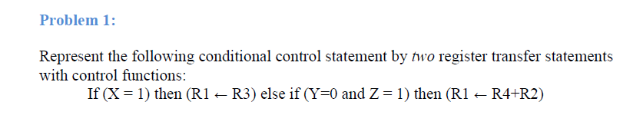

Register Transfer language (RTL)

Slide 8
Register Transfer language (RTL)
AR
Memory
Points to remember:
Two Special purpose registers:
Memory Address Register AR
Memory Data Register DR
Read and Write Control lines
200
DR
200 | 50
300
AR
Read: DR ← M[AR]
DR
Write: M[AR] ← DR

Slide 9
Register Transfer language (RTL)
AR
Read =1
Memory
Points to remember:
Two Special purpose registers:
Memory Address Register AR
Memory Data Register DR
Read and Write Control lines
200
DR
200 | 50
300
AR
Read: DR ← M[AR]
DR
Write: M[AR] ← DR

Slide 10
Register Transfer language (RTL)
AR
Read =1
Memory
Points to remember:
Two Special purpose registers:
Memory Address Register AR
Memory Data Register DR
Read and Write Control lines
200
DR
200 | 50
300
50
AR
Read: DR ← M[AR]
DR
Write: M[AR] ← DR

Slide 11
Register Transfer language (RTL)
AR
Write =1
Memory
Points to remember:
Two Special purpose registers:
Memory Address Register AR
Memory Data Register DR
Read and Write Control lines
200
DR
200 | 50
300 | 70
50
AR
300
Read: DR ← M[AR]
DR
Write: M[AR] ← DR
70

Slide 12
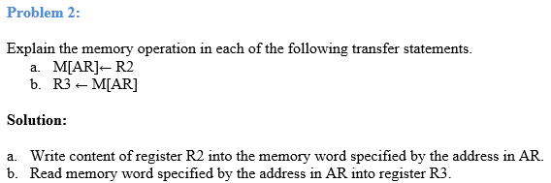
Register Transfer language (RTL)

Slide 13
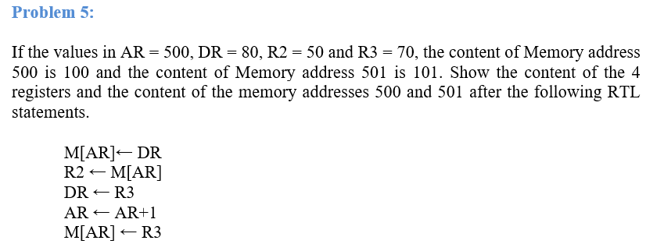
Register Transfer language (RTL)
Memory
500 | 100
501 | 101
AR
DR
R2
R3
500
80
50
70

Slide 14
Register Transfer language (RTL)
Memory
500 | 80
501 | 101
AR
DR
R2
R3
500
80
50
70

Slide 15
Register Transfer language (RTL)
Memory
500 | 80
501 | 101
AR
DR
R2
R3
500
80
80
70

Slide 16
Register Transfer language (RTL)
Memory
500 | 80
501 | 101
AR
DR
R2
R3
500
70
80
70

Slide 17
Register Transfer language (RTL)
Memory
500 | 80
501 | 101
AR
DR
R2
R3
501
70
80
70

Slide 18
Register Transfer language (RTL)
Memory
500 | 80
501 | 70
AR
DR
R2
R3
501
70
80
70

Slide 19
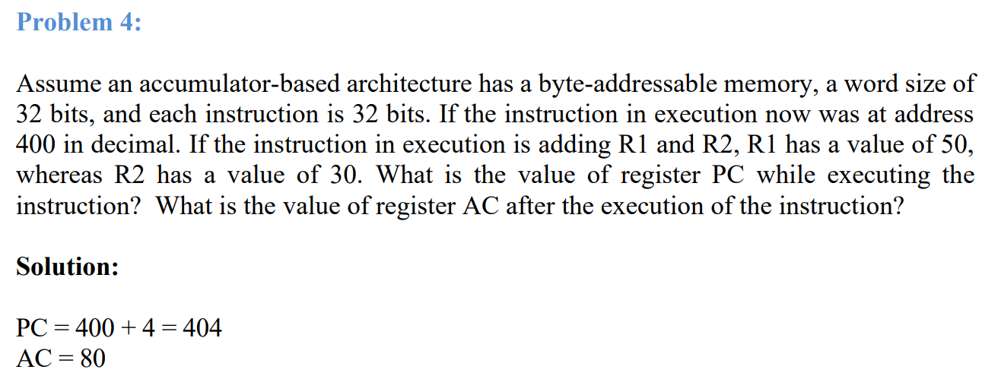
Register Transfer language (RTL)
Memory
400 | 8 bits
401 | 8 bits
402 | 8 bits
403 | 8 bits
404 | 8 bits
 | 8 bits
Instruction

Slide 20
Part 2: Common Data Bus

Slide 21
Part 2: Common Data Bus
R15
R2
R1
R0
0101
R15← R0 = R15 ← bus, bus← R0
What really happens, the control unit let R0 give its content to the bus, then sets the load of R15 to 1 to load the content of R0

Slide 22
Part 2: Common Data Bus
0 1 0 1
R15
R2
R1
R0
Load=1
0101
R15← R0 = R15 ← bus, bus← R0
What really happens, the control unit let R0 give its content to the bus, then sets the load of R15 to 1 to load the content of R0

Slide 23
Part 2: Common Data Bus, how the bus is designed
S1
0
S0
0
We need to revise a multiplexer:
Mux
4x1
a
00
a
b
01
c
10
d
11
Number of selections = log₂(inputs)

Slide 24
Part 2: Common Data Bus, how the bus is designed
A simple bus for 4 registers and each register is 2 bits only.
Mux
4x1
Mux
4x1
S1
S1
S0
S0
00
01
10
11
00
01
10
11
A0
B0
C0
D0
A1
B1
C1
D1
A1 A0
B1 B0
C1 C0
D1 D0

Slide 25
Part 2: Common Data Bus, how the bus is designed
Bus ← A
D ← Bus
D ← A =
Mux
4x1
Mux
4x1
S1
S1
S0
S0
00
01
10
11
00
01
10
11
A0
B0
C0
D0
A1
B1
C1
D1
A1 A0
B1 B0
C1 C0
D1 D0

Slide 26
Part 2: Common Data Bus, how the bus is designed
Bus ← A
D ← Bus
D ← A =
A0
A1
Mux
4x1
Mux
4x1
0
0
0
0
S1
S1
S0
S0
00
01
10
11
00
01
10
11
A0
B0
C0
D0
A1
B1
C1
D1
A1 A0
B1 B0
C1 C0
D1 D0

Slide 27
Part 2: Common Data Bus, how the bus is designed
Bus ← A
D ← Bus
D ← A =
A0
A1
Mux
4x1
Mux
4x1
0
0
0
0
S1
S1
S0
S0
00
01
10
11
00
01
10
11
A0
B0
C0
D0
A1
B1
C1
D1
A1 A0
B1 B0
C1 C0
D1 D0
Load=1

Slide 28
Part 2: Common Data Bus, how the bus is designed
Num of Mux = num of bits in a register
Num of inputs = num of registers
Selection lines = log₂(inputs)
Mux
4x1
Mux
4x1
S1
S1
S0
S0
00
01
10
11
00
01
10
11
A0
B0
C0
D0
A1
B1
C1
D1
A1 A0
B1 B0
C1 C0
D1 D0

Slide 29
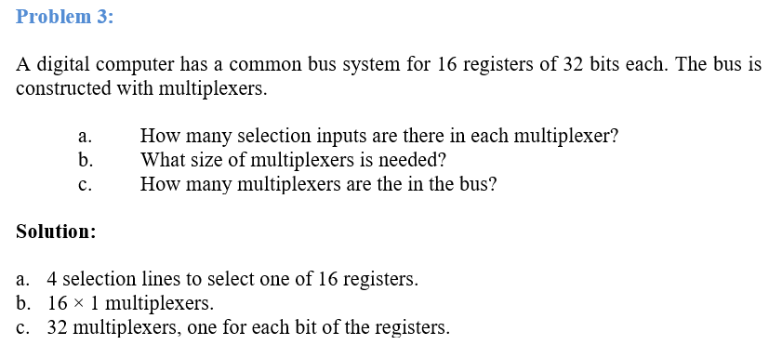
Part 2: Common Data Bus
Num of Mux = num of bits in a register
Num of inputs = num of registers
Selection lines = log₂(inputs)

Slide 30
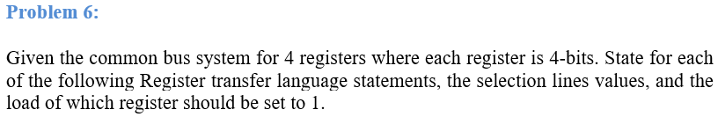
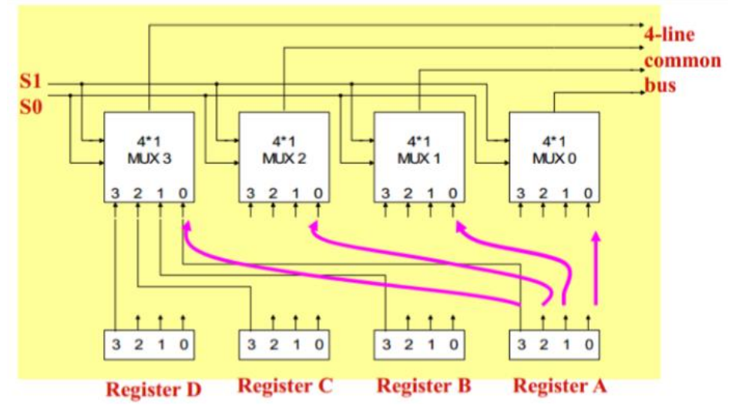
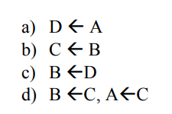
Part 2: Common Data Bus
 | S1 S0 | Load
a) D <- A | 0 0 | Register D
b) C <-B | 0 1 | Register C
d) B <- C, A<- C | 1 0 | Registers A, B

Slide 31
Part 3: Types of ALU Micro-operations

Slide 32
Part 3: Types of ALU Micro-operations
Types of ALU micro-operations
Data Transfer
Arithmetic
Logical
Shift
D ←A

Slide 33
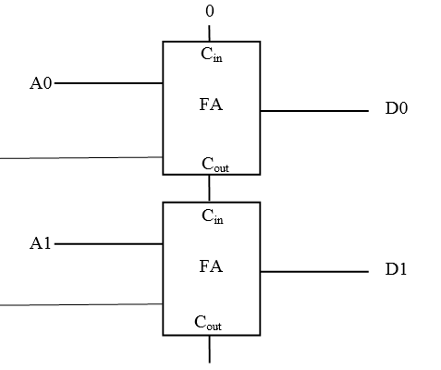
Part 3: Types of ALU Micro-operations (Arithmetic micro-operations)
Addition:
D ← A+ B
1
A 0011
+ B 0010
--------
D 0101
B0
B1

Slide 34
Part 3: Types of ALU Micro-operations (Arithmetic micro-operations)
0011
1’s complement 1100
+ 1
----------
1101
2’s complement, this is -3
Subtraction:
D ← A+ B’ + 1
1
5 0101
- 3 0011
--------
Has to be converted to 5+(-3).
We have to get negative representation of 3 by applying 2’s complement
B0
B1

Slide 35
Part 3: Types of ALU Micro-operations (Arithmetic micro-operations)
1
Increment:
D ← A+ 1
A 0011
0001
--------
D 0100
1
0
0
0

Slide 36
Part 3: Types of ALU Micro-operations (Arithmetic micro-operations)
1
Decrement:
D ← A - 1
A 0101
1111
--------
D 0100
1
0
0001
1110
+ 1
----------
1111
2’s complement OF 1 IS ALL ONES
1
1

